Slide 1
Log File Analysis & Reporting System
A Command-Line Application for Web Server Log Processing and Analytics

Slide 2
Table of Contents
Abstract
Objective
System Architecture
Technology Stack
Database Design
Implementation Methodology
Module Design
Testing & Validation
Results & Demonstrations
Conclusion
Future Work
Q&A Session

Slide 3
Abstract
This project presents a CLI-based system that automates the process of analyzing web server log files. The tool implements an ETL pipeline that extracts data using regex, transforms and cleans it, and loads it into a normalized MySQL database. The CLI supports generating various analytical reports such as traffic stats, error monitoring, and user behavior.
Key features include real-time monitoring, batch processing, and user agent normalization. The system is scalable, modular, and educationally valuable.

Slide 4
Objective
To create a tool that automates log file processing, enabling efficient web traffic analysis and system monitoring.
Aim: Provide a bridge from raw log data to actionable insights using CLI - driven automation.
Scope:
Apache Common Log Format parsing and processing
MySQL database integration with optimized schema design
Comprehensive CLI with multiple command options
Multiple report types including traffic analysis, error monitoring, and user statistics
User agent parsing and normalization
Batch processing for large files
Configuration management system
Real-time monitoring of a log file for new entries
Comprehensive testing suite

Slide 5
System Architecture
4-Layer Architecture
Presentation Layer
CLI Interface
Argument Parsing
Output Formatting
Business Logic
Parsing
Transformation
Report generation
Data Access Layer
MySQL Operations
Connection Management
Query Optimization
Data Storage
MySQL Database
Optimized Schema
Indexing Strategy

Slide 6
Technology Stack
Programming Language
Python 3.8+
- Excellent text processing and CLI development capabilities
Database
MySQL 8.0+
- Reliable performance for analytical queries
Key Libraries
MySQL-connector-python
- Native MySQL driver with connection pooling
CLI Framework
argparse - For parsing command-line arguments and building interactive tools
Output Formatting
tabulate - Formats database results into clean, readable tables
Configuration Management
configparser + Environment Variables - Flexible and secure configuration handling

Slide 7
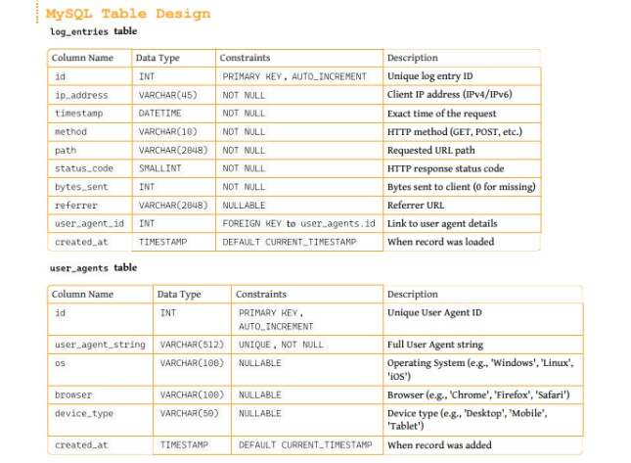
Database Design
Optimization Features:
Normalization: User agent data separated for storage efficiency
Indexing: Strategic indexes on timestamp, ip_address, and status_code
Data Integrity: log_hash ensures uniqueness and prevents duplicates
Performance: Schema optimized for fast, analytical SQL queries

Slide 8
Implementation Methodology
ELT Pipeline Implementation
A structured pipeline for log analysis and reporting
Load Phase
Batch insertions into MySQL
Transaction handling with rollback safety
Indexed schema for optimized queries
Extract Phase
Regular expression parsing
Supports Apache Common Log Format
Efficient batch file processing
Handles malformed entries gracefully
Transform Phase
Data type conversion (IP, status codes, bytes)
Timestamp normalization with time zone awareness
User agent parsing: OS, browser, device
Data validation for accuracy and integrity

Slide 9
Module Design
Core Modules:
Log Parser Module: Regex-based parsing with compiled patterns
MySQL Handler: Database operations and query optimization
CLI Manager: Command-line interface and orchestration
Configuration Module: Settings management and validation
Report Types:
Traffic Analysis: Top IP addresses by request count
Error Monitoring: HTTP status code distribution
Temporal Analysis: Hourly traffic patterns
Content Analysis: Most requested URLs
User Analytics: Traffic by OS/browser
Security Insights: Error logs by date

Slide 10
Testing & Validation
Testing Strategy
Unit Testing
Log parser validation
Database operations
Data transformation logic
Configuration management
Integration Testing
End-to-end workflow
Database connectivity
CLI command execution
Error handling scenarios
Performance Testing
Large file processing
Memory usage analysis
Query performance
Concurrent processing

Slide 11
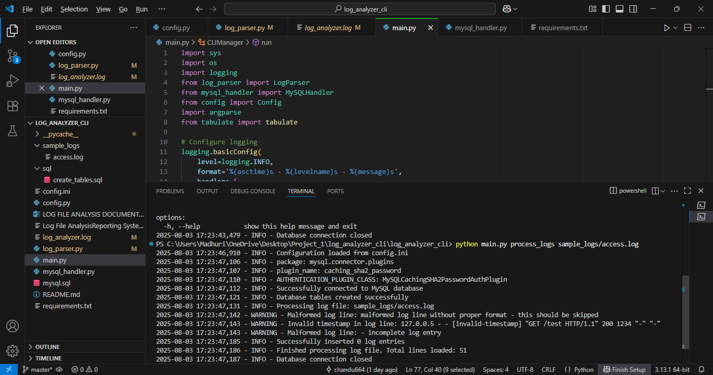
Results & Demonstrations
The log processor efficiently filtered out invalid data and avoided corrupting the database with incomplete information.
Highlights the robust error-handling mechanism in the implementation.
Emphasizes the importance of clean and well-formatted logs for successful parsing and storage.

Slide 12
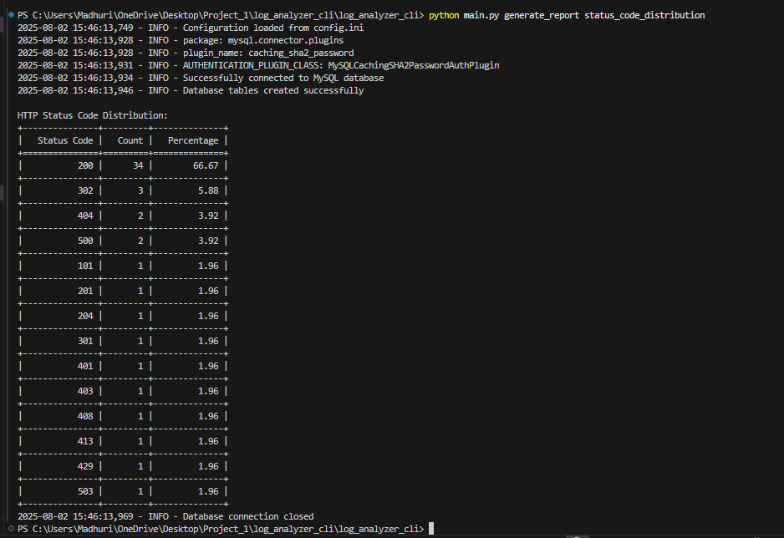
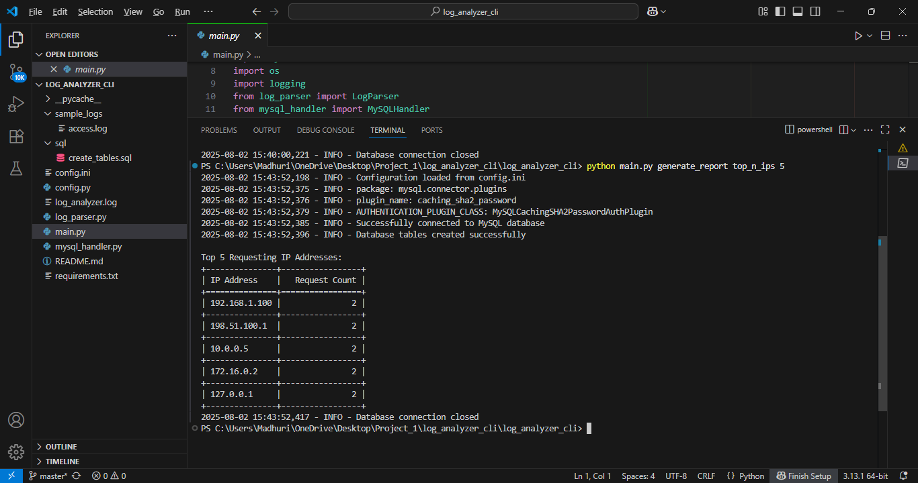
Results & Demonstrations
Reports Generated
Top IPs
Status code distribution

Slide 13
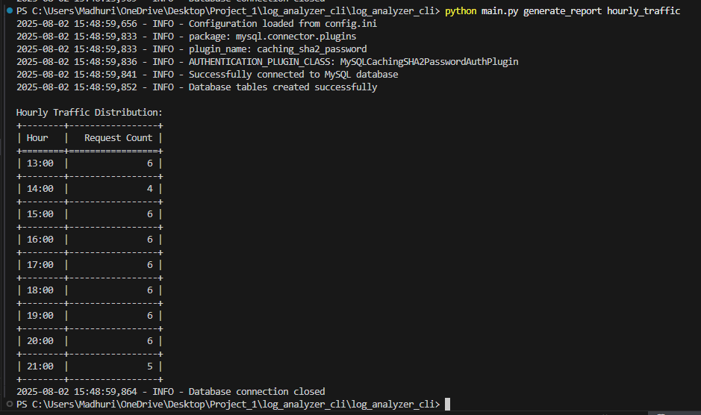
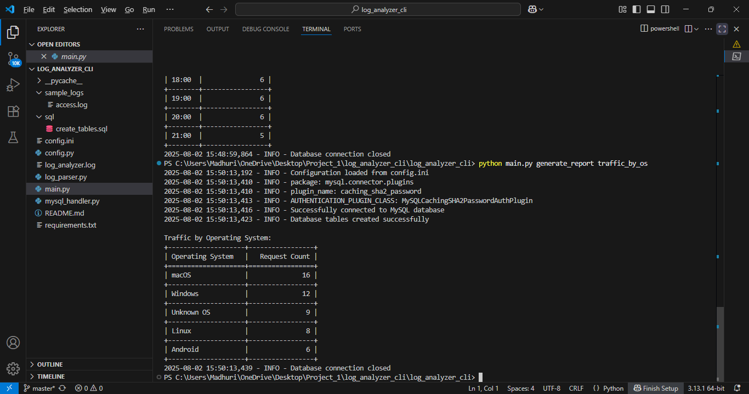
Results & Demonstrations
Hourly traffic patterns
OS and browser-based traffic breakdown

Slide 14
Conclusion & Achievements
The Log File Analysis & Reporting System has been successfully developed and implemented, achieving all primary objectives outlined in the project specification. The system demonstrates a comprehensive understanding of data engineering principles, database design, and software architecture.
Key Achievements:
Robust Parsing Engine
Optimized Database Design
Performance Optimization
Data Integrity
Scalability

Slide 15
Future Scope
Web Dashboard Interface:
Develop React-based web dashboard for visual analytics
Advanced Analytics:
Implement statistical analysis functions (percentiles, moving averages)
Add trend analysis and forecasting capabilities
Performance Improvements:
Implement connection pooling for database operations
Add caching layer for frequently accessed reports

Slide 16
THANK YOU

